Slide 1
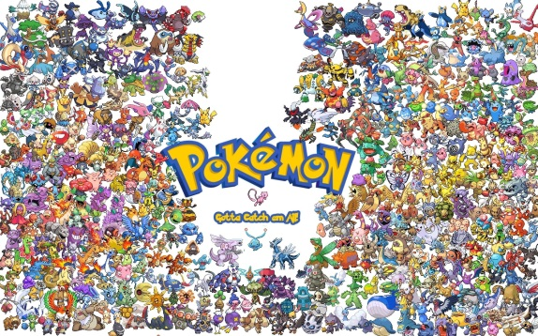

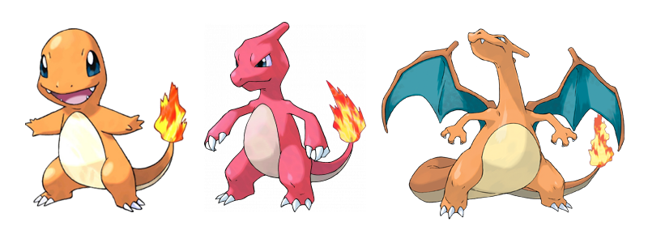
String ID
Int level
String attack
---------------------
levelUp
(ab) cry
(ab) learn(int level)
(ab) evolve
String name
Pokemon poke
---------------------
giveRareCandy()
Abstract superclass
Pokemon
String id
Int level
String attack
---------------------
Cry @override
learn(int level) @override
(ab) evolve @override
(subclass)
Charmander
(subclass)
String id
Int level
String attack
---------------------
Cry @override
learn(int level) @override
(ab) evolve @override
fly
Charizard
Trainer

Slide 2
Abstract superclass
Pokemon
Pokemon poke
------------------
(subclass)
Problem:
We want our reference value as Pokemon type, for other pokemon, but cannot reach unoverrided methods like fly().
Charmander
(subclass)
Charizard
---
fly
Trainer

Slide 3
Stack
Heap
Dog doggy; (reference)
Dog doggy2;
Cat kitty;
new Dog(); (object)
new Dog();
new Cat();
If we use -> doggy = doggy2
Stack
Heap
Dog doggy; (reference)
Dog doggy2;
Cat kitty;
new Dog(); (object)
new Dog();
new Cat();
kitty = doggy (X) =>>> difference reference variable type

Slide 4
int a = 4;
Long b= 5;
a=b (X)
BUT
a=(int)b (O) ➔ Casting primitive variables
Same with reference variables
Cf) doggy2=doggy (O) =>Java already knows that doggy is a dog ➔ UpCasting (automatically done.)
Dog doggy = new Dog();
Animal doggy2 = new Dog();
doggy=doggy2 (X)
BUT
doggy=(Dog)doggy2 (O) ➔ DownCasting
➔ Changing the remote controller type with those functions

Slide 5
Pokemon lizamon = new Charizard();
lizamon.cry();
lizamon.fly();
Charizard chari = lizamon
((Charizard)lizamon.)fly();
Charizard chari = (Charizard)lizamon;
Charmander firey = new Charmander();
((Charizard)firey).fly();
Lizamon=(Charizard)firey; =>(ClassCastException)
Stack
Heap
Pokemon lizamon
Charizard instance
Charizard chari
Charmander firey
Charmander instance

Slide 6
Charmader firey = new Charmander(); Charizard chari = (Charizard) firey; is ClassCastException. ➔ in order to evolve a pokemon. casting doesn’t work. I need to make a new object that carries all the object values and methods so comes the idea of copying(cloning) I used shallow copying constuctors https://www.youtube.com/watch?v=QaCYMgyprtc

